Slide 1

Mobile Application for Young Mother
Author: Repina Anastasia, BSE143
Research supervisor: Akhmetsafina R.Z.,
Deputy Head, Associate Professor of Faculty of Computer Science
Higher School of Economics, Moscow, 2018
www.hse.ru
Notes:
Hello, my name is Anastasia Repina. I am the student of the group 143. Today I would like to give you a general overview of my graduation project whose main goal is to create an android application for young mothers.

Slide 2
Agenda
Related work
Survey
Application architecture and design
Technologies
Notes:
I’m going to develop four main points. First, I’ll tell you about the similar projects and application which were already done by other people. Then, I’ll speak about the survey which I done before the coding started. The next point is connected with the application itself and the final one is the technologies which are used for the application creation. If you have any questions I’d be grateful if you could leave them until the end.

Slide 3
Related Work
Application name | Price (₽) | Baby’s health monitoring | Mother’s health monitoring | Data analysis | Wearable data collection | Stability | Timetable
Health Kit | free | - | + | + | + | + | -
Baby diary | free | + | - | - | - | + | +
Baby Connect | 159 | + | - | + | - | + | +
Ya rodilsya | 149 | + | - | + | - | + | +
FirstYear | free | + | - | + | - | +/- | +
Mi Fit | free | - | + | + | + | - | -
This work | free | + | + | + | + | + | +
Notes:
In the research the preparatory step is very important.
During this step it is necessary to analyze the already existing projects and understand what their benefits and drawbacks are.
So, later, you will be able to create your own work taking the problems of competitors into account.
None of the products which I have looked at (you can see them on the slide) solve the problem which I would like to solve with the help of my application.
The existing projects usually just monitor only mother’s OR baby’s health whereas I want to do these two parts inside one project.
This step will let young mothers analyze not only their child’s but also their own health, so it will be possible to see the correlation between the changes of mood, health, nutrition of both mother and baby.
That is why I decided to include monitoring of baby’s AND mother’s health as well as opportunities to analyze the data and collect information from wearable devices.
In order to create a good application, it is also necessary to choose the parameters which will be collected and analyzed.

Slide 4
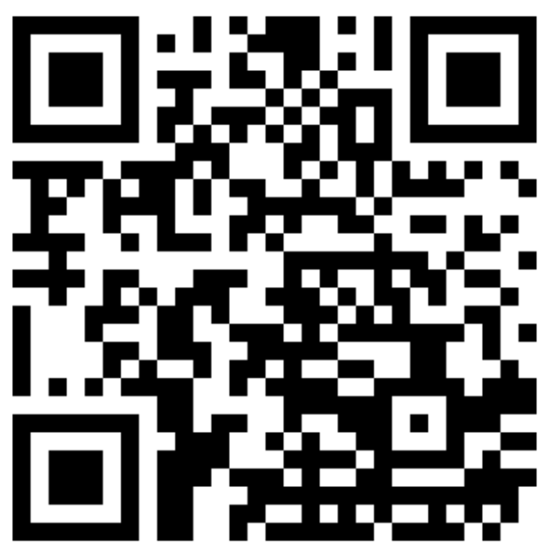
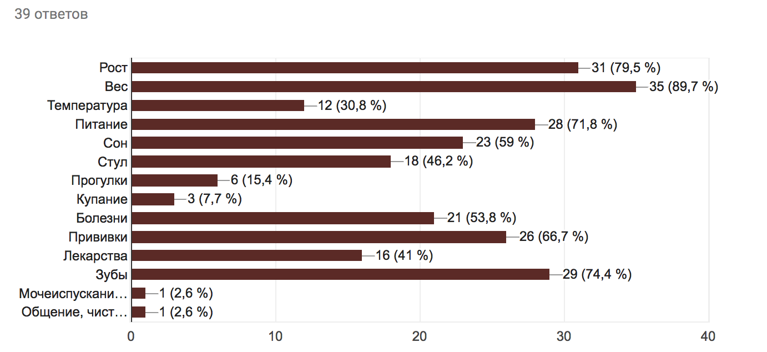
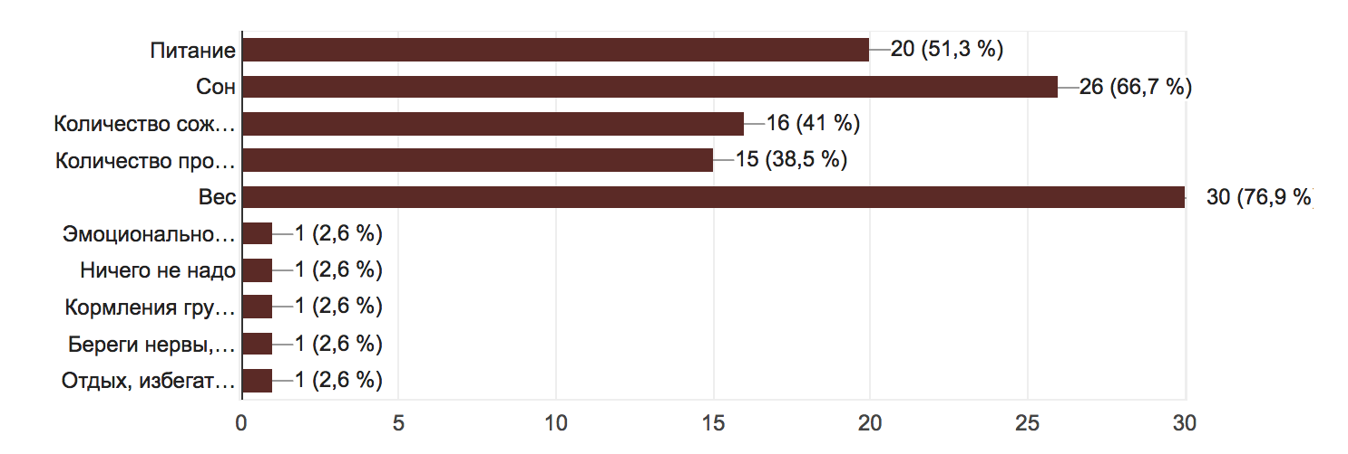
Survey
Baby
Young mother
Notes:
That is why the next step was conducting a survey. 40 young parents have answered several questions connected with health and nutrition of them and their baby’s. On the slide you can see the aggregated results which helped reveal key characteristics, which were later added to the application. The survey was conducted in Russian, so the presented charts are in Russian.

Slide 5
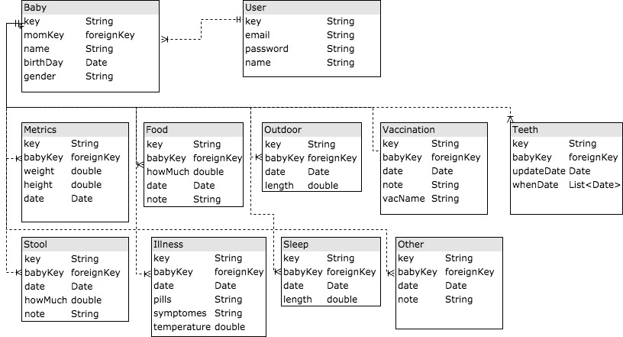
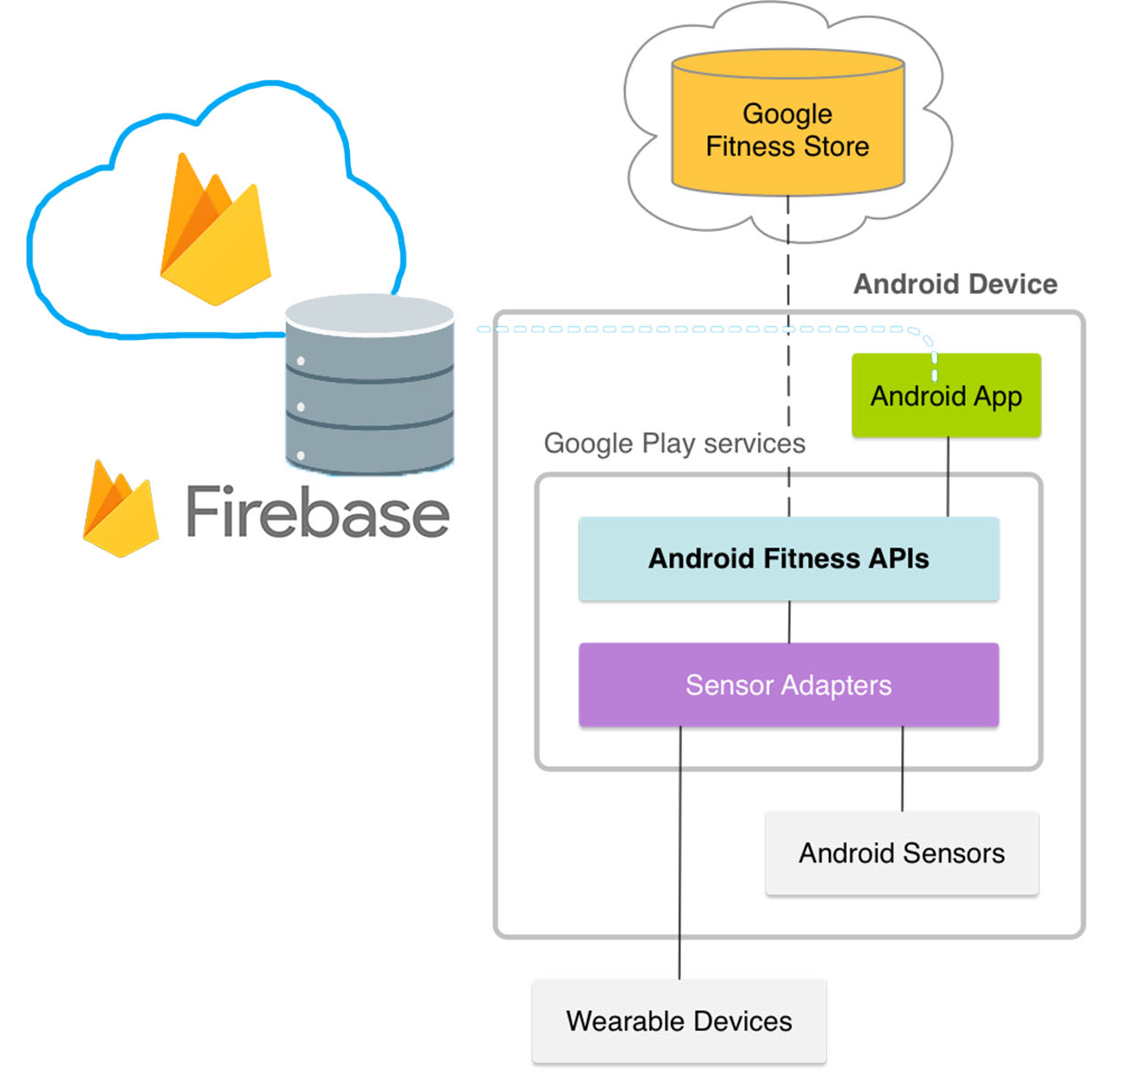
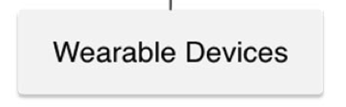
Application architecture and design
Manual input
Notes:
This leads me to a point connected with app architecture and design.
On the slide the DB diagram is presented together with the primitive scheme of the data flow inside the app.
As you can see the Firebase service was chosen as the data storage, here I save all the information related to health and nutrition.
The main source of data for mothers is wearable devices whereas the baby’s data is added manually.
There are a lot of different wearable devices and trying to connect all of them inside the project will be very complicated, so I decided to solve this problem with the help of Google Fit service, which already has functionality which enables connecting bands and watches and downloads some data from them.
So, I use Fitness and History APIs in order to collect all the necessary parameters.

Slide 6
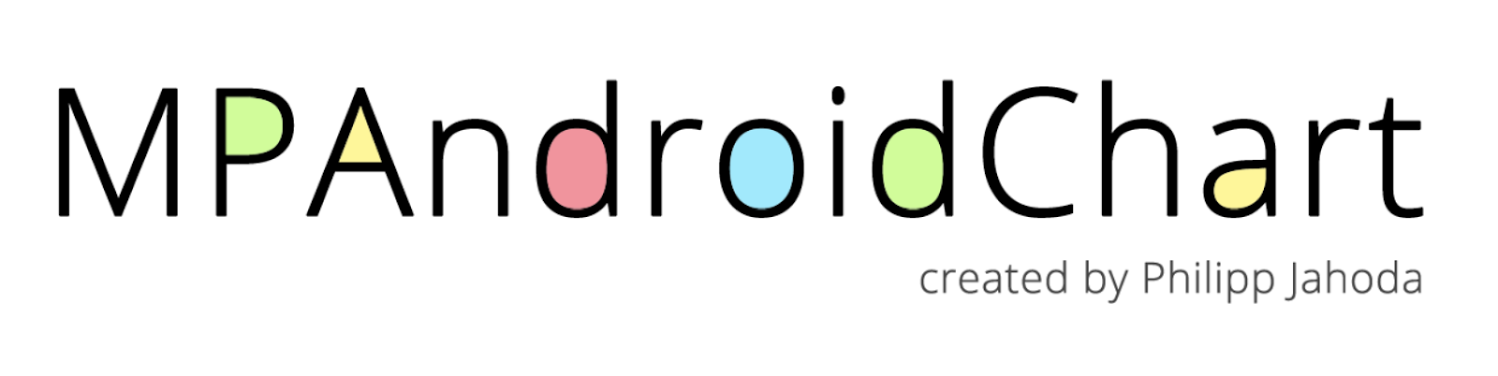
Technologies
Notes:
Of course, all the mentioned steps will be impossible to perform without the help of a variety of technologies. Now we are talking about them. In order not to lose anything I use GitHub. The programming language is Java and I use Android studio to write my code. I have already mentioned Google Fit and Firebase during my speech. And the MPAndroidChart is a fantastic library for graphs and charts drawing.

Slide 7
Summary
Android application
Functions for both: mother and baby
Google Fit, Google Firebase, MPAndroidChart
Notes:
Let me remind you what we have looked at today.
I am creating an Android application for both young mothers AND their babies.
Application will help to monitor health and nutrition as the baby’s health is being highly linked to the mothers one, so it may be really helpful to see the correlation inside one application.
With the help of the technologies like Google Fit, Google Firebase and MPAndroidChart the main goal of this project will definitely be achieved.

Slide 8
References
C. Kratzke, C. Cox. Global Journal of Health Education and Promotion, vol. 15, pp. 72-82, 2012.
E. Derbyshire, D. Dancey. “Smartphone Medical Applications for Women’s Health: What Is the Evidence-Base and Feedback?”. International Journal of Telemedicine and Applications, vol. 2013, Article ID 782074, 2013.
Google Inc., “Health-tracking platform.” Internet: https://www.google.ru/intl/en_en/fit/, [Jan. 5, 2018].
V. Gay, P. Leijdekkers. “Bringing Health and Fitness Data Together for Connected Health Care: Mobile Apps as Enablers of Interoperability”. J Med Internet Res, vol. 17, p. 260, 2015.
Apple Inc., “Health informatics mobile application.” Internet: https://www.apple.com/ru/ios/health/, [Jan. 5, 2018].
BabyJoyApp, “Child’s growth and development mobile application.” Internet: https://play.google.com/store/apps/details?id=com.babyjoy.android, [Jan. 5, 2018].
Seacloud Software, “Child’s growth and development mobile application.” Internet: https://play.google.com/store/apps/details?id=com.seacloud.bc, [Jan. 5, 2018].
S. Nikitin, “Child’s growth and development mobile application.” Internet: https://itunes.apple.com/ru/app/a-rodilsa/id477391124?l=en&mt=8, [Jan. 5, 2018].
Y. Ding, “Child’s growth and development mobile application.” Internet: https://itunes.apple.com/ru/app/firstyear-baby-feeding-timer-sleep-nappie-log/id645810513?l=en&mt=8, [Jan. 5, 2018].
Anhui Huami Information Technology Co. Ltd., “Health informatics mobile application.” Internet: https://play.google.com/store/apps/details?id=com.xiaomi.hm.health, [Jan. 5, 2018].
IDC Corporate USA, “Worldwide Quarterly Mobile Phone Tracker”, Internet: https://www.idc.com/tracker/showproductinfo.jsp?prod_id=37, [Jan. 12, 2018].
Google Inc., “Mobile and web application development platform.” Internet: https://firebase.google.com/, [Jan. 5, 2018].
(2010, Sep. 9). “J&J Launches Aid Program for Mothers.” Reuters. [On- line]. Available: http://www.reuters.com74/article/2010/09/09/us-jj-aid-program-idUSTRE6883ID20100909 [Dec. 1, 2017].
Notes:
Here you can see the literature and Internet resources I have already used during my work.

Slide 9
Thank you
Author: Repina Anastasia, BSE143
Higher School of Economics, Moscow, 2018
www.hse.ru
Notes:
Thank you for your attention. If you have any questions I’d be happy to answer them.

